Slide 1



Slide 2



 | Slope Bins 4 | Smear Count 25
Block number | Alpha w/ Henderson Hasselbalch | Chi Chi_max = 2.2
[0 50] | 0.040012 | 1.160000
[50 75] | -0.278451 | 0.720000
[75 125] | -0.519707 | 0.608000
[125 156] | -0.154453 | 0.529032

Slide 3


 | Slope Bins 4 | Smear Count 31
Block number | Alpha w/ Henderson Hasselbalch | Chi Chi_max = 2.2
[0 31] | 0.001103 | 0.922581
[31 62] | -0.386873 | 0.703226
[62 93] | -0.290146 | 0.967742
[93 496] | 0.037164 | 1.098759
[496 527] | -0.064533 | 0.819355
[527 620] | 0.010682 | 0.756989
[620 647] | -0.103326 | 0.696296

Slide 4


Response to stimuli given composition
Same data
Effect of composition given environment

Slide 5


NFL, pH 7.44, phos 1.5e (locs from LCMS)
Non-phos NFL
Block number | Alpha w/ Henderson Hasselbalch | Chi Chi_max = 3.2
[0 50] | 0.040012 | 1.540000
[50 75] | -0.278451 | 0.960000
[75 125] | -0.519707 | 0.868000
[125 156] | -0.154453 | 0.690323
 | Slope Bins 4 | Smear Count 25
Block number | Alpha w/ Henderson Hasselbalch | Chi Chi_max = 3.2
[0 50] | -0.019988 | 1.540000
[50 75] | -0.278451 | 0.960000
[75 125] | -0.519707 | 0.868000
[125 156] | -0.154453 | 0.690323

Slide 6


NFM, pH 7.44, phos 1.5e (locs from LCMS)
 | Slope Bins 4 | Smear Count 32
Block number | Alpha w/ Henderson Hasselbalch | Chi Chi_max = 3.0
[0 32] | 0.079143 | 1.275000
[32 64] | -0.186340 | 1.125000
[64 96] | -0.327964 | 1.181250
[96 160] | -0.460694 | 0.787500
[160 224] | -0.124999 | 1.115625
[224 288] | -0.023510 | 0.956250
[288 352] | -0.242085 | 1.003125
[352 384] | -0.031302 | 1.125000
[384 416] | -0.123860 | 1.050000
[416 438] | 0.046945 | 1.281818

Slide 7


NFH, pH 7.44, phos 1.5e (locs from LCMS)
 | Slope Bins 4 | Smear Count 36
Block number | Alpha w/ Henderson Hasselbalch | Chi Chi_max = 3.2 | Chi Chi_max = 3.0
[0 36] | 0.000945 | 1.266667 | 1.20000
[36 72] | -0.527455 | 0.900000 | 0.85000
[72 324] | -0.208376 | 1.729365 | 1.628571
[324 396] | -0.111195 | 1.416667 | 1.333333
[396 432] | -0.152824 | 1.344444 | 1.266667
[432 647] | -0.033955 | 1.077209 | 1.015814

Slide 8


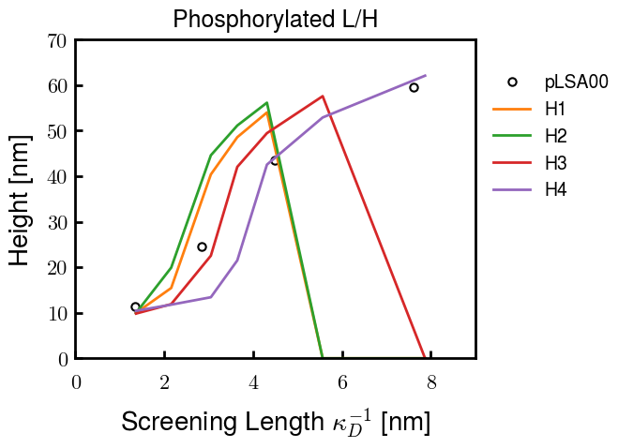

Phos block dashed
Phos block dashed
pH3 ./1 running; same params as native (b5v20c3)

Slide 10
Binary results

Slide 11



Matrix Approach
Updated 04/04/2023

Slide 12














H Vol decrease (by v)
H Vol decrease (by b)
Desired “linearity” by tuning /thresh/ based on polymer density of expelled NFL
L Vol decrease (by b)
Comes at severe cost of overall height. Have to minimize outer concentration to approach pure thresh of 1e-06

Slide 13














H Vol decrease (by v)
H Vol decrease (by b)
Chimax 3.5
Desired “linearity” by tuning /thresh/ based on polymer density of expelled NFL
L Vol decrease (by b)
Comes at severe cost of overall height. Have to minimize outer concentration to approach pure thresh of 1e-06

Slide 14








F (3.5)
Chimax 3.5
Chimax 3.0
Scaled by 1.5
Scaled by 1.6
Scaled by 1.6
Scaled by 1.5
Scaled by 1.5
Scaled by 1.5
Scaled by 1.8
Scaled by 1.8

Slide 15
















Last test: same stiffness factor (b^3/v0) but with varying total volume

Slide 16












H Vol decrease (by v)
H Vol decrease (by b)
a2C_30
a2D_30
a2E_30
Rerun for Cs
b1C_30
b1D_30
b1E_30
L Vol decrease (by b)
a1C_30
a1D_30
a1E_30
g1C_30
g1D_30
g1E_30
Rerun for Cs

Slide 17












H Vol decrease (by v)
H Vol decrease (by b)
a2C
a2D
a2E
b1C
b1D
b1E
Block 4 (NFL end)
L Vol decrease (by b)
a1C
a1D
a1E
g1C
g1D
g1E

Slide 18









H Vol decrease (by v)
Chimax 3.5
H Vol decrease (by b)
a2C_30
a2D_30
a2E_30
b1C_30
b1D_30
b1E_30
L Vol decrease (by b)
a1C_30
a1D_30
a1E_30
g1C_30
g1D_30
g1E_30

Slide 19







For i as L and H:
Pure height profiles
Mixed height profiles
Current L library
Current H library
Skip; marginal increase in vol prob not enough
Move onto chi3.0; larger NFL vol library

Slide 20





NFL
All plotting wrong L pure; look only at purp
NFH
H volume too low to neutralize L (v = 31 nm3/c)

Slide 21







H volume v = 60 nm3/c

Slide 22







H volume too low to neutralize L

Slide 23










NFH, V = 70
L30

Slide 24





NFH & NFL v = 0.15
a2D
b1D
g1D

Slide 25





Based on NFH b5v15c3, apply VL = VH
NFL and NFH are from same amino acids but diff chain lengths. Should VL = VH?
L30 / H70
L80 / H20
L30 / H70
L80 / H20

Slide 26






L30 / H70
L80 / H20
L30 / H70
L80 / H20

Slide 27
L Fitting

Slide 28


VL = VH

Slide 29







Try b change, v same as H (0.15)
Phi unrealistic (?)
Phi unrealistic
Phi very unrealistic
Phi very unrealistic

Slide 30






Try similar params to H
5.6
11.2
16.8
28
56
7.5
11.25
18.75

Slide 31







Try similar params to H, b0.36
7.8
15.6
23.4
31.2
Unrealistic vol
Not very sensitive to v; not high enough to intersect neighboring chains (function of b and sigma)

Slide 32


Continuation from prev params

Slide 33







v2.7 and some fine
b1.50 v2.7 c3.2
b1.75 v2.7 c3.2
b1.75 v2.5 c3.2
b1.75 v2.5 c3.0
b2.0 v2.7 c3.2
b2.25 v2.7 c3.2
b2.50 v2.7 c3.2
Phi too small to decrease v0

Slide 34










b2.0 v10.0 c3.0
b2.0 v8.0 c3.0
b2.0 v6.0 c3.0
b2.0 v4.0 c3.0
b2.0 v2.0 c3.0
Phi limit
b1.8 v10.0 c3.0
b1.8 v8.0 c3.0
b1.8 v6.0 c3.0
b1.8 v3.0 c3.0
b1.8 v2.0 c3.0
Phi limit

Slide 35





b1.6 v10.0 c3.0
b1.6 v8.0 c3.0
b1.6 v6.0 c3.0
b1.6 v2.0 c3.0
b1.6 v1.5 c3.0
Phi limit

Slide 36









b2.0 v2.7 c3.2
b3.0 v3.5 c3.5
b3.0 v7.0 c3.5
b3.0 v7.0 c3.0
Phi too small
Phi too small to decrease v0
b4.0 v12.0 c3.0
b5.0 v20.0 c3.0
b5.0 v20.0 c4.0
b5.0 v5.0 c3.0
b5.0 v10.0 c3.0
Phi too small to decrease v0

Slide 37





v20
b5.0 v20.0 c3.0
b4.5 v20.0 c3.0
b4.0 v20.0 c3.0
b3.5 v20.0 c3.0
v10
b5.0 v10.0 c3.0
b4.0 v10.0 c3.0
b3.0 v10.0 c3.0
b2.0 v10.0 c3.0

Slide 38




b2.00 v2.70 c3.20
b2.00 v2.75 c3.20

Slide 39
NFH fitting (from NFL best fit)

Slide 40








b1.00, v0.50, c3.2
b2.00, v4.00, c3.2, th2.5e-02
b1.00, v2.00, c3.2
b1.00, v1.00, c3.2

Slide 41
Mixture

Slide 42



Slide 43


b = 0.75

Slide 44





Slide 45
b = 1.0

Slide 46





Slide 47
b = 1.25

Slide 48




Chi 2.6
Bad vol frac

Slide 49








b25v0
b25v1
b25v2
b25v3

Slide 50




Chi 2.8
Bad vol frac

Slide 51





Slide 52
b = 1.50

Slide 53






Chi 2.8
Bad vol frac

Slide 54





Slide 55

b = 2.00
v4 = 0.25*b^3

Slide 56


Bad vol frac

Slide 57



Slide 58
Fine tune

Slide 59



b1.25, v1.95, c3.0
b1.50, v3.38, c3.0
b2.00, v4.00, c3.0
Norm seems to capture kinked behavior

Slide 60




Slide 61



b1.25, v1.95, c3.2
b1.50, v3.38, c3.2
b2.00, v4.00, c3.2

Slide 62




Slide 63


b1.25
b1.50
b2.00
c2.8
c3.0
c3.2

